Slide 1


From Web Forms to Blazor
Introducing Blazor Web Forms Components
Jeffrey T. Fritz -- @csharpfritz

Slide 2
The Problem
ASP.NET Web Forms and .NET Framework 4.8 continue to be supported, run only on Windows, but are not receiving new features
We’d like to use containers, and new web features like Web Assembly and Blazor
Different programming models and different framework versions

Slide 3
Wrong Solution: MVC
Dramatic shift in programming model
No components available, straight HTML output
More testable
Still ASP.NET, and can move to .NET Core / .NET 5 with modifications
Can run in the same application as Web Forms, creating a “FrankenApp”

Slide 4
Wrong Solution: Angular / Vue / React
Similar UI component-driven development model
Open Sourcce components available
Unit Testing frameworks available
Change from C# / VB to JavaScript
Does not match 1:1 with the code and architecture presented in ASPX pages / ASCX controls

Slide 5
Solution: Blazor
Similar UI component-driven development model
Open Sourcce components available
Unit Testing frameworks available - bUnit
Keep writing C#
Use .NET Standard / .NET 5 libraries
What if it could match 1:1 with the code and architecture presented in ASPX pages / ASCX controls?

Slide 6
Web Forms and Blazor - Similarities
Web Forms
Blazor Server-Side
Application configured in global.asax
Pages and Controls
Build with raw HTML mixed with controls
Renders content on server
Execute and interact with JavaScript
Application configured in Startup.cs
Components that can be Pages
Build with Razor templates and components
Renders content on server
Execute and interop with JavaScript

Slide 7
Web Forms and Blazor - Differences
Web Forms
Blazor Server-Side
ASPX files with <% %> notation
ViewState
Postback
MasterPages
.NET Framework 1.0 - 4.x
Libraries in .NET Framework
Runs in IIS on Windows
Razor files with @ notation
State managed on server
SignalR channel
LayoutComponents
.NET Core 3.0+
Components in .NET Standard 2+
Runs on Windows, Mac or Linux

Slide 8

Exploration Demo:
What if we could make a Component that LOOKS like the asp:Control?

Slide 9
How can we make components?
Razor Class Library
Throw some .razor and .razor.cs files in there
Reference in a ‘Sample’ project to see what it looks like
Lather, rinse, repeat

Slide 10
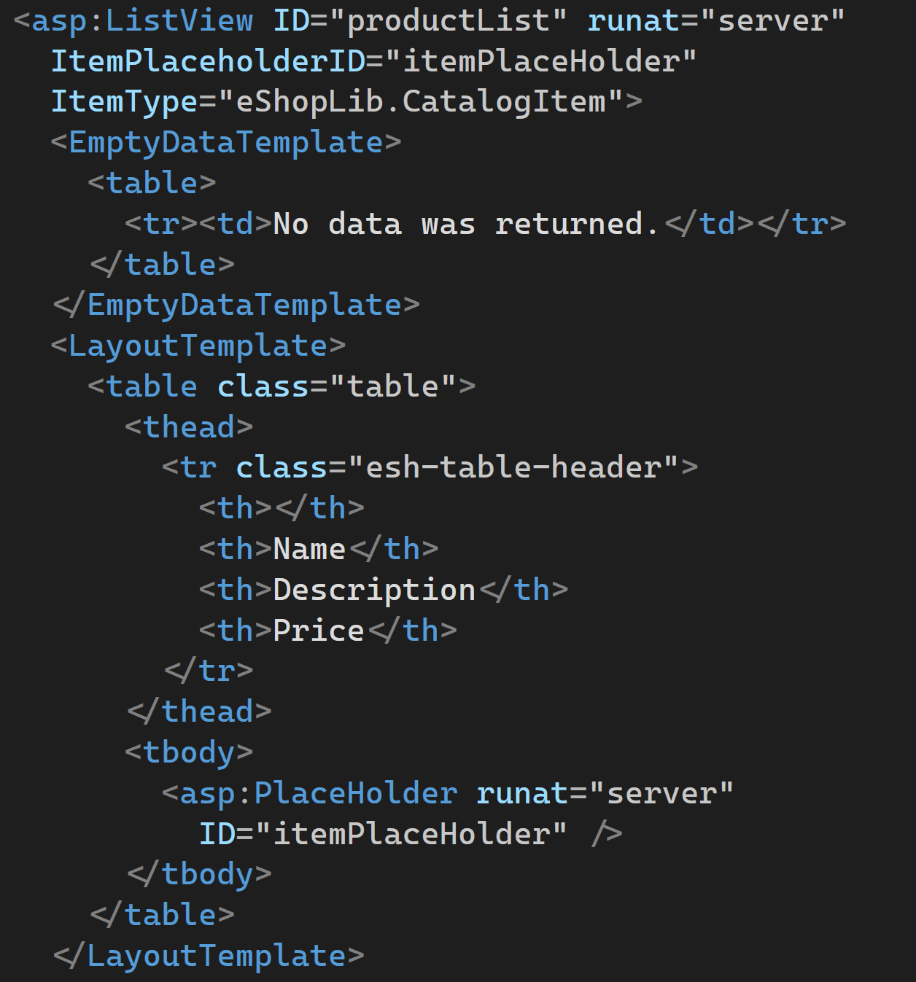
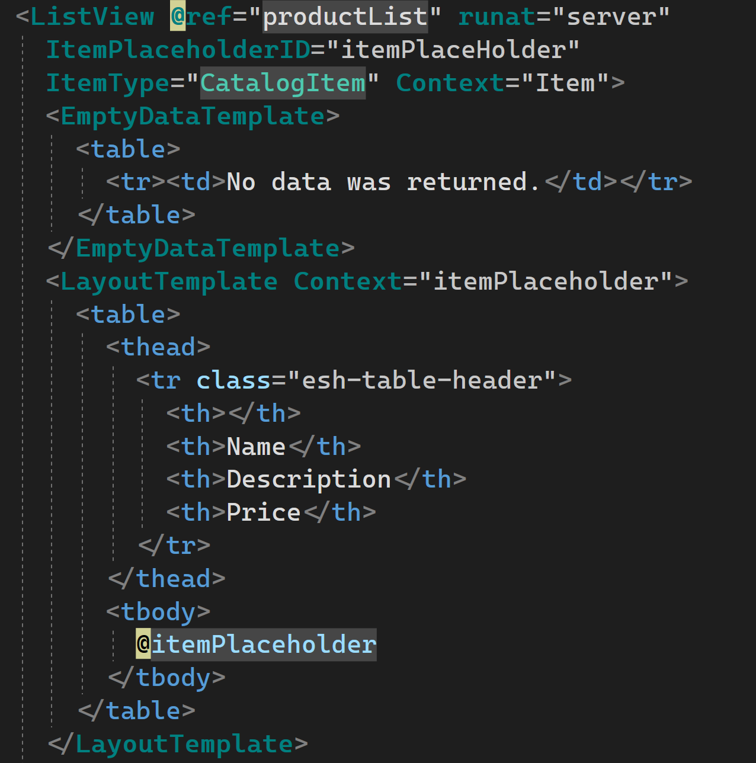
ASP.NET Web Forms
Blazor

Slide 11
Test Components?
bUnit from Egil Hansen – github.com/egil/bunit
Build unit tests to verify the component delivers matching HTML from the original ASP.NET control
More than 230 tests written so far…

Slide 12

Test Demo:
Let’s test our components!

Slide 13
Package Components?
NuGet
dotnet pack
Deployed to NuGet.org
Automated with Azure Pipelines

Slide 14
Documentation and Samples
Markdown in docs folder
Published with mkdocs and GitHub actions
https://fritzandfriends.github.io/BlazorWebFormsComponents/
Samples bundled as a Docker container
Deployed to Azure App Service
https://blazorwebformscomponents.azurewebsites.net/

Slide 15

Docs and Samples:
Let’s build our components!

Slide 16
Migration Process
Move business logic to class libraries
Create a new Blazor project
Reference the class libraries
Migrate static files
Migrate configuration
Re-write ASPX / ASCX as .razor files
We wrote an eBook: https://aka.ms/blazor-ebook

Slide 17
CodeFactory – codefactory.software
CodeFactory is a a pattern automation tool that uses your source code like a data model
Build templates that can be automated and attached to Visual Studio 2019
Templates available for refactoring, migrating, and scaffolding
Template available to migrate ASPX markup to .razor for Blazor

Slide 18

Migrate to Blazor FAST
Let’s use CodeFactory

Slide 19

Blazor for ASP.NET Web Forms Developers
https://dotnet.microsoft.com/learn/aspnet/architecture
http://bit.ly/blazorwebformscomponents
Twitter.com/csharpfritz
Twitch.tv/csharpfritz
Github.com/csharpfritz
YouTube.com/csharpfritz

